Slide 1
A Dashboard Creation on Diabetic Patient Data

Slide 2
Motivation
Diabetes leads to serious health problem.
No cure for Diabetes.
Its consequences avoided or delayed with diet, physical activity, medication
Regular screening and treatment for complications

Slide 3
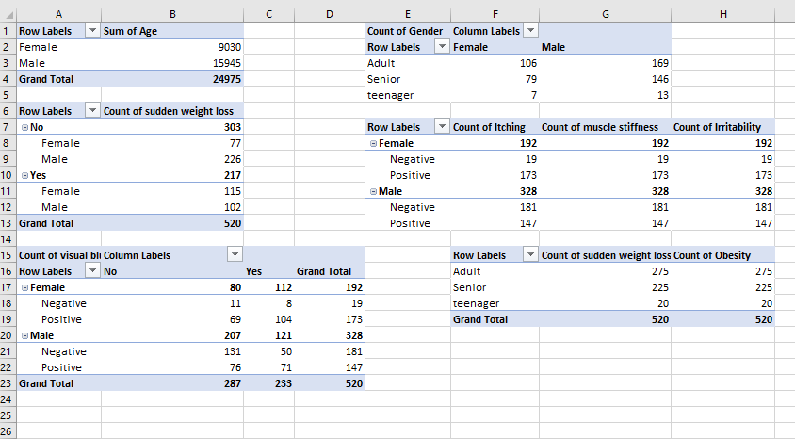
Pivote Tables

Slide 4
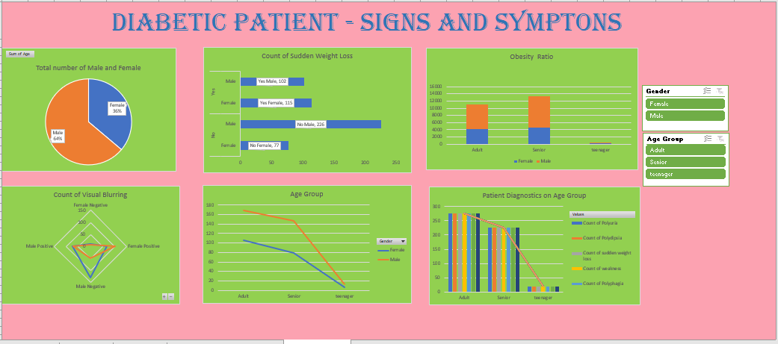

Slide 5
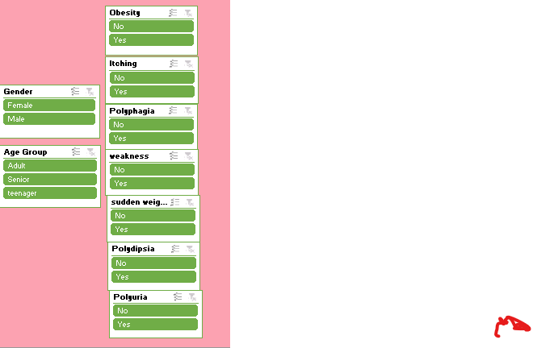
Slicers inserted into worksheets

Slide 6
Insights
Adult group is having higher chances of causing sugar.
Obesity is a main symptom of causing diabetes.
There is a chances of causing Diabetes in the teenager age group.
Males proving highly reactive agents for diabetes.

